Slide 1
Some results on cyclic vertex (edge) connectivity
Jun Liang
South China Normal University
6 July 2019

Slide 2
Outline
Research Background
Introduction and some results
Future work

Slide 3
Research Background
The concept of cyclic connectivity was proposed by Tait (1880, [1]) .
It has appeared in some theories developed to solve the Four Color Conjecture (Tutte 1960,[2]).
The cyclic connectivity was later changed to the cyclic edge connectivity to distinguish the cyclic vertex connectivity.

Slide 4
Research Background
The definition of cyclic vertex connectivity first appears in Peroche’s paper (1983, [3]), which studied the relations among several sorts of connectivity.

Slide 5
Research Background
The cyclic (vertex and edge) connectivity is an important graph parameter .
They can replace the usual connectivity in applications where the considered graphs have bounded maximum degree, such as ,robustness of local computer networks and parallel computer architectures or the stability of tertiary structure of proteins (Z. Dvořák et al., 2004, [4]).

Slide 6
Research Background
The cyclic vertex connectivity is a type of conditional connectivity that reflects how many nodes the network fail within, but at least two core networks are not broken.

Slide 7
Terminology
For a graph G, a set S of vertices (edges) in G is a cyclic vertex (edge) cutset if G−S is not connected and at least two components of G−S contain a cycle respectively.
The cyclic vertex connectivity cκ(G) is the cardinality of a minimum cyclic vertex cutset in G.

Slide 8
Terminology
For example, a cyclic vertex cutset {s₀,s₁,s₂,s₃,s₄,s₅,s₆}

Slide 9
Some results -- cyclic edge connectivity
Dvoˇrák et al. presented an O(v² log² v)-algorithm for cyclic edge connectivity of cubic graphs. ([4])
Lou and Wang (2005,[5]) gave algorithms determining the cyclic edge connectivity of k-regular graphs, and the time complexity in Lou and Liang (2014,[6]) is O(k⁹v⁶).
Lou and Wang (2008,[7]) also obtained an algorithm for determining whether the cyclic edge connectivity of the graph is infinite, and the time complexity is O(|V||E|).

Slide 10
Some results --cyclic edge connectivity of planar graphs
Plummer (1972,[8]) proved that the cyclic edge connectivity of a 5-connected planar graph is at most 13, but the cyclic edge connectivity of a 4-connected planar graph can be any integer greater than or equal to 4.
Lu Yuting et al. (2009, [9]) obtained an algorithm for determining the edge connectivity of planar graphs, and its time complexity is O(|V|⁴).

Slide 11
Some results --cyclic vertex connectivity
Lou and Holton (1993, [10]) proved that when the cyclic edge connectivity of a k-regular graph is large enough, the cyclic vertex connectivity of this graph can be greater than any given lower bound, and vice versa.
All cubic graphs with the cyclic vertex connectivity g$≤$ck(G)$≤∞$ are characterized. (under review)

Slide 12
Some results --The algorithms for determining the cyclic vertex connectivity
We gave polynomial time algorithms for cyclic vertex connectivity of
cubic graphs O(v^{15/2}). (2017,[11])
4-regular graphs O(v^{15/2}). (2019, [12])
k-regular graphs with fixed k O(v^{15/2}k⁷k^{9k^2}). (2019,[13])

Slide 13
An algorithm for cyclic vertex connectivity of cubic graphs
The main idea of the algorithm is that: we firstly find all induced cycles of length less than or equal to x and put these cycles into a set F. Then for any two disjoint cycles in F, we find a vertex cutset to separate them. Then the minimum vertex cutset is the minimum cyclic vertex cutset, and the cardinality of the minimum cyclic vertex cutset is cyclic vertex connectivity ck(G).
Key point: Finding out the value of x and proving the correctness of the algorithm.

Slide 14
If we can prove that the number of vertices of each branch containing the cycle in G−S (assumed to be D1) is at least 2^{c/4−1,} then v(G)≥|V(D1)| ≥ 2^{c/4−1} ,
i.e., c ≤ 4 (log ₂v +1). (c is the length of the shortest cycle contained in branch D1).
It means that the value of x is 4 (log ₂v +1).

Slide 15
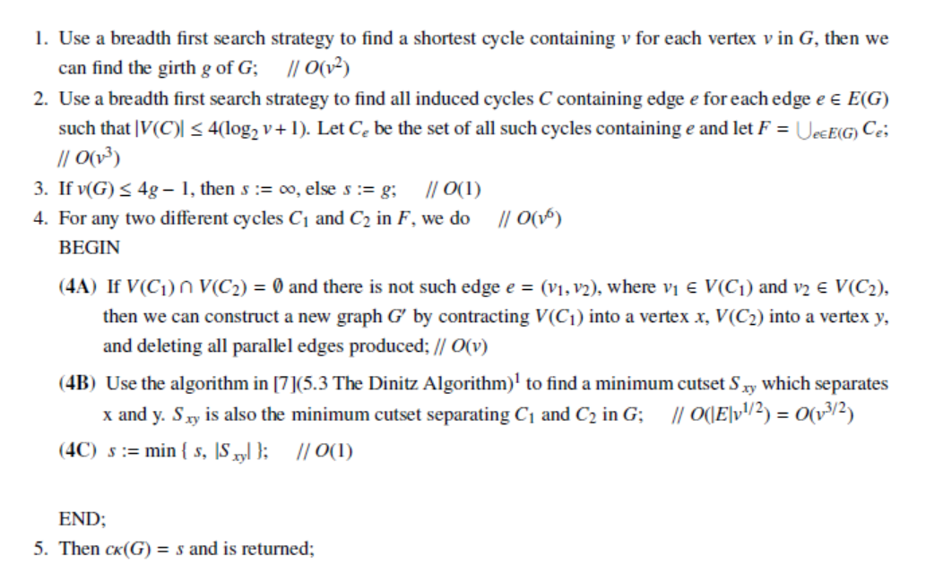
Algorithm 1: determining the cyclic vertex connectivity of cubic graphs

Slide 16
Some results for cubic graphs:
Theorem 1. Let G be a connected k-regular graph. If v(G) ≥2g(k -1), then ck(G) ≤ (k-2)g, where g is the girth of G.
Theorem 2. For any k-regular graph G containing a cycle with girth g and v(G) < 2g(k-1), then (1) if k = 3, then g ≤ 10. (2) if k = 4, then g ≤ 7. (3) if k = 5 or 6, then g ≤ 6. (4) if 7 ≤ k ≤ 25, then g ≤ 5. (5) if k ≥26, then g ≤ 4.
Theorem 3. Let G be a k-regular graph with girth g ≥7, suppose that C is an induced cycle in a connected component of G, then |N(C)| ≥ g(k-2).
Theorem 4. Suppose that |S | < g, g ≥7, and the length of a minimum cycle in each component containing cycles is greater than or equal to 16, then at least 2^{c/4-1} vertices are contained in every component having cycles.

Slide 17
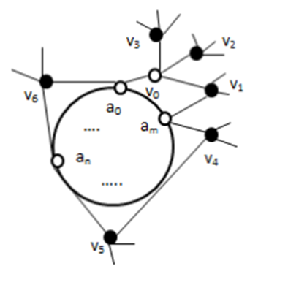

Slide 18
Suppose a tree has 2⁰ + 2⁰ + 2¹ + 2² + … + 2^{c/4-2} = 2^{c/4-1} vertices and is fully contained in D1, then the tree is called a full-tree. Suppose a tree has 2⁰ + 2⁰ + 2¹ + 2² + … + 2^{c/4-3} = 2^{c/4-2} +1 vertices contained in D1, then the tree is called a half-tree .
If D1 contains a full-tree or two vertex-disjoint half-trees, then we can get the conclusion of this theorem.

Slide 19
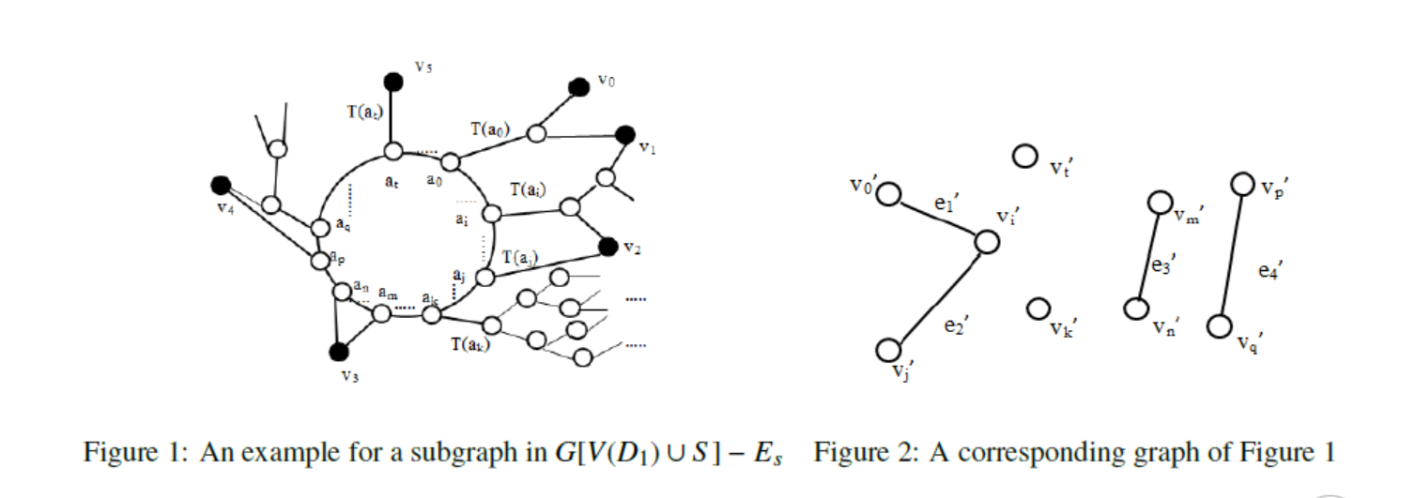

Slide 20
The algorithm for 4-regular graphs
Lemma 1. Let G be a 4-regular graph with girth g ≥ 7. Suppose the cardinality of cyclic vertex cutset |S|≤ 2g– 1 and the ranges of length c of a minimum cycle C1 in component D1 of G - S are g < c < 2(g - 4) and c ≥16. Then D1 contains at least (3^{c/4-1} + 1)/2 vertices.
Lemma 2. Let G be a 4-regular graph with girth g ≥19. Suppose the cardinality of cyclic vertex cutset |S | ≤2g-1 and the range of length c of a minimum cycle C1 in a component D1 of G -S is 2(g -4) ≤ c ≤ 3g -2. Then D1 contains at least (3^{c/4-1} + 1)/2 vertices.

Slide 21
Lemma 3. Let G be a 4-regular graph with girth g ≥ 19. Suppose the cardinality of cyclic vertex cutset |S | ≤ 2g -1. Then a component D1 containing a cycle in G-S contains at least (3^{c/4-1} + 1)/2 vertices.

Slide 22
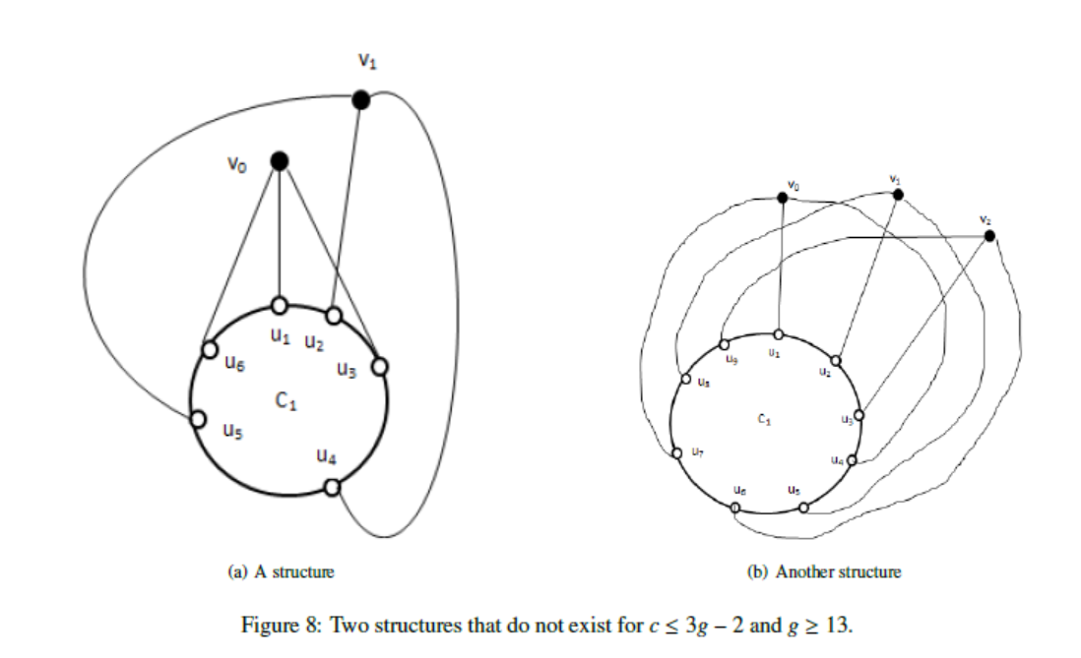

Slide 23
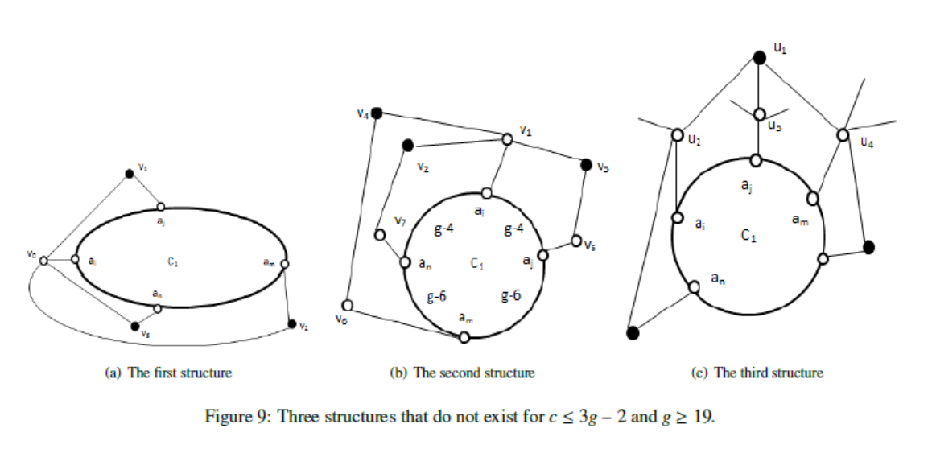

Slide 24
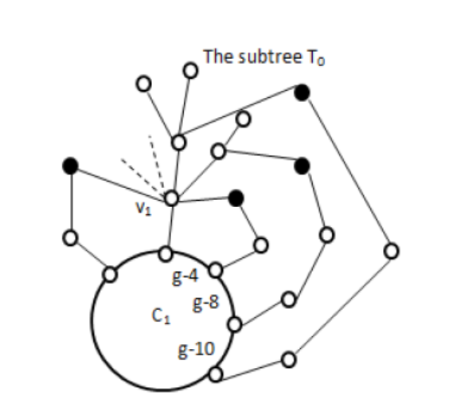
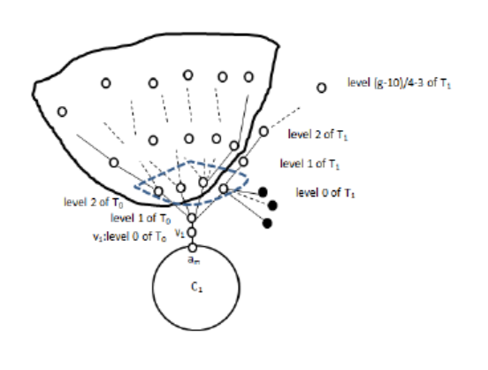
The algorithm for k-regular graphs with Fixed k

Slide 25
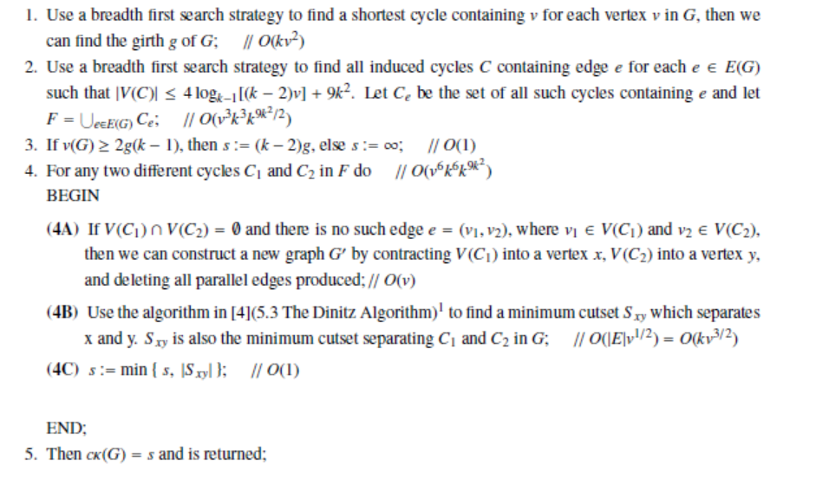
Algorithm 2

Slide 26
Future work
According to the characterization of cubic graphs with ck (G) > g, the efficient algorithm of the cycle vertex connectivity of cubic graphs is designed.
Characterizing the general graph with cycle vertex connectivity ck (G) $≠∞$.
Designing an algorithm for determining the cycle vertex connectivity of a general graph.
Designing the random algorithms for the cyclic edge (vertex) connectivity.

Slide 27
References
[1] P.G. Tait, Remarks on the coloring of maps, Proc. Roy. Soc. Edinburg 10 (1880), pp. 501–503.
[2] Tutte WT, A non-Hamiltonian planar graph. Acta Math Acad Sci Hung 11 (1960) :371–375.
[3] B. Peroche, On several sorts of connectivity, Discrete Math. 46 (1983), pp. 267–277.
[4] Z. Dvořák, J. Kára, D. král’, and O. Pangrác, An algorithm for cyclic edge connectivity of cubic graphs, SWAT 2004, LNCS 3111 (2004), pp. 236–247.
[5] Lou D and Wang W. An efficient algorithm for cyclic edge connectivity of regular graphs[J]. Ars Combinatoria, 2005, 77:311–318.

Slide 28
[6]Lou D and Liang K. An Improved Algorithm for Cyclic Edge Connectivity of Regular Graphs[J]. ARS
[7]Lou D and Wang W. Characterization of graphs with infinite cyclic edge connectivity[J]. Discrete Mathematics, 2008, 308(11):2094–2103.
[8]Plummer M. On the cyclic connectivity of planar graphs[J]. Graph Theory and Applications, 235–242,Springer, 1972.
[9] Lu Y and Lu X. An Efficient Algorithm for Cyclic Edge Connectivity of Planar Graphs[C].// Information Processing, 2009. APCIP 2009. Asia-Pacific Conference on, vol. 2. IEEE,2009, 193–195.
[10] Lou D and Holton DA. Lower bound of cyclic edge connectivity for n-extendability of regular graphs[J]. Discrete mathematics, 1993, 112(1-3):139–150.

Slide 29
[11] J. Liang, D. Lou and Z. Zhang. A polynomial time algorithm for cyclic vertex connectivity of cubic graphs[J].International Journal of Computer Mathematics, 2017, 94(7): 1501-1514.
[12] J. Liang, D. Lou . A polynomial algorithm determining cyclic vertex connectivity of k-regular graphs with fixed k[J]. Journal of Combinatorial Optimization, 2019.
[13] J. Liang, D. Lou , Z. Qin , et al. A polynomial algorithm determining cyclic vertex connectivity of 4-regular graphs[J]. Journal of Combinatorial Optimization, 2019.

Slide 30
Thank you!

